Slide 1
CM 1607 ENGLISH COMMUNICATION SKILLS
Lecture 6 covering LO 1 and LO 2
Tenses
Critical thinking and writing and Reflective writing

Slide 2

Recall - TENSES -
Take a look at handout 1 for week 6. Fill in the chart as shown. Then check your answers.

Slide 3
What is Critical Thinking?
A few basic points:
Not taking anything for granted or at face value
Looking closely at details
Evaluating many options before making a decision
Avoiding bias, prejudice etc.
Not only about thinking analytically but thinking differently
Let’s look at handout 2.

Slide 4
Let’s practice some critical thinking…
Let’s start with an easy one:
Identify what is common to the following words.
September, April, November, June
2. Describe these
shapes in any other way than
the obvious

Slide 5
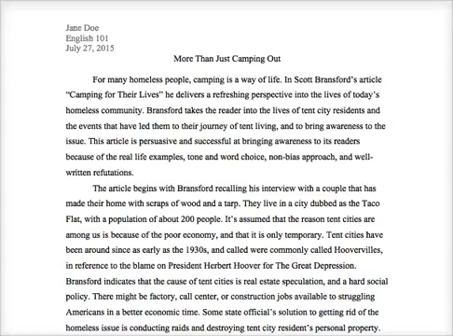
Video – Effective Critical Analysis

Slide 6
Discuss and come up with 10 important words/phrases that are often associated with Critical Thinking and Analysis.
Bias, prejudice, reasoning, open-mindedness, critical, perception, evidence, conclusion, author’s position, narrow-minded, bigoted, doubtful, well-researched, recognized sources, inconsistencies, flawed reasoning, mistakes in reasoning, making logical connections, construct and evaluate arguments.

Slide 7
Critical Writing
The worst case scenario: Imagine that each of you have been stranded in an unknown faraway area. Your mobile battery just died. You have no way to charge it. You can find your way to the main road, but there is a curfew and the Army is everywhere. You can’t get in touch with anyone. For one minute think of all the survival tactics you will use. Then discuss as a group and come up with the most creative ideas of survival. Share it with the class, later write it for practice.

Slide 8
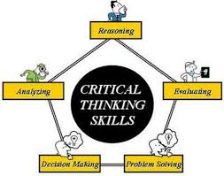
☺ ☺ ☺ ☺ ☺ ☺
Reflective writing
Take a look at the note in Handout 3. Let’s go through it quickly.

Slide 9
Reflective writing
Big paper – building a silent conversation
Think silently for 3 minutes. Reflect on some of the things you took for granted, before the pandemic, which you didn’t have when you were house bound. Then think of someone you really care about and love. What would happen if that person caught the Corona Virus. How would it impact your life? Etc. Really reflect. Write a short paragraph about 75 words.

Slide 10

Summing up
Critical Thinking, critical writing, critical reading, critical listening are all very useful skills to develop as undergraduates. They will be of use to you right through your university journey and life as well.
Thinking, reading, writing, and listening reflectively are also important at university level. These
skills need to be cultivated and used
as an undergraduate.

